Slide 1

"Loan Default Risk Analysis & Insights"
"An Analytical Overview of Default Patterns, Loan Risk Factors, and Strategic Recommendations"
Presented by: Md Aamir Nawab

Slide 2
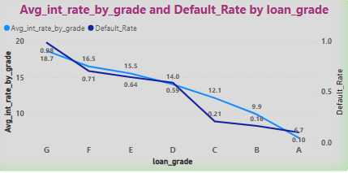
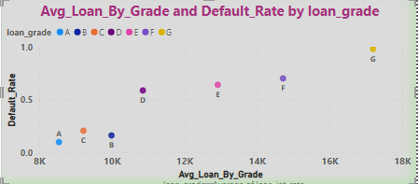
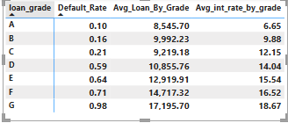
Insights :
Interest Rate & Default Rate (First Chart & Table)
Higher loan grades (A, B) = Lower interest rates & lower default rates.
Lower loan grades (F, G) = Higher interest rates & much higher default rates.
Example:
Grade A: 6.65% interest, 10% default rate.
Grade G: 18.67% interest, 98% default rate.
Conclusion: Higher-risk borrowers (poor credit) are charged more interest but still default.
2.Loan Amount & Default Rate (Second Chart & Table)
Higher loan grades (A, B, C) have lower default rates despite having different loan amounts.
Lower loan grades (E, F, G) have higher loan amounts and higher default rates.
Example:
Grade A loan amount: $8,545 (10% default rate).
Grade G loan amount: $17,195 (98% default rate).
Conclusion: Bigger loans tend to default more, especially for risky borrowers.
Key Takeaways:
✔ Loan grade is the best risk predictor. ✔ Risky borrowers pay more interest but still default often. ✔ Lenders need to be cautious with large loans to risky borrowers.

Slide 3
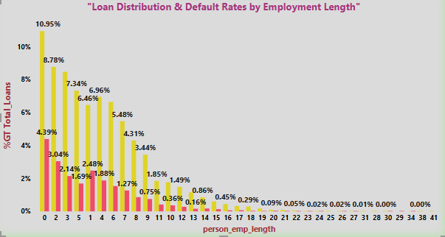
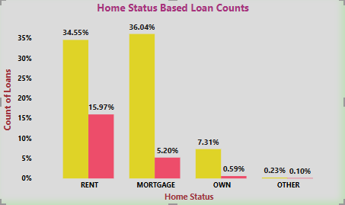
Insights:
Most Loans Go to Renters & Mortgage Holders
36.04% of loans are taken by people with a mortgage.
34.55% of loans are taken by renters.
Highest Default Rate Among Renters
15.97% of renters defaulted, the highest among all homeownership types.
Mortgage holders default less (5.20%), showing more financial stability.
Lowest Defaults Among Homeowners
Only 7.31% of loans go to outright homeowners, and they have the lowest default rate (0.59%).
Other categories (e.g., "Other") have almost no defaults.
Key Takeaways:
✔ Renters are the riskiest borrowers with the highest default rates. ✔ People with mortgages borrow the most but are more reliable than renters. ✔ Outright homeowners are the safest borrowers with the lowest defaults.

Slide 4
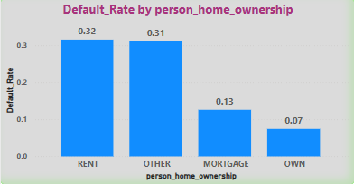
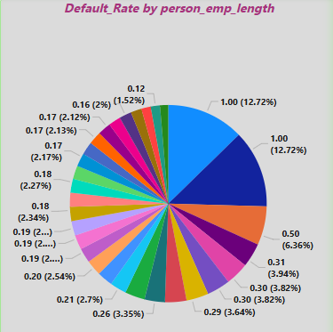

1. Employment Length vs. Loan Status Distribution
As employment length increases, the percentage of total loans decreases significantly.
Loan defaults are higher in the lower employment length categories, suggesting that job stability plays a role in loan repayment ability.
2. Loan Distribution by Home Ownership Status
Individuals with "Mortgage" (36.04%) and "Rent" (34.55%) hold the majority of loans.
Borrowers who own their homes account for a small percentage (7.31%) of total loans.
This indicates that people who rent or have mortgages rely more on loans compared to homeowners.
3. Home Ownership and Loan Default Rate Comparison
Default rates are highest among renters (32%) and "Other" (31%) categories.
Borrowers with mortgages have a much lower default rate (13%), while those who own homes have the lowest default rate (7%).
This suggests that homeownership provides financial stability, reducing the likelihood of loan default.
Lenders might consider homeownership as a key factor when assessing loan risk.
These insights can help financial institutions optimize lending policies, focusing on borrower stability factors like employment length and homeownership.

Slide 5
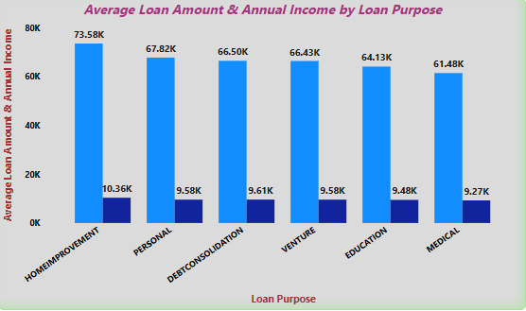
Insights :
Highest Loan Amount:
Home Improvement loans have the highest average loan amount (73.58K), indicating that people borrow the most for home renovations.
Loan Amounts Across Categories:
Other high loan amounts include Personal (67.82K), Debt Consolidation (66.50K), and Venture (66.43K).
Medical loans (61.48K) have the lowest average loan amount among the categories.
Income vs. Loan Trends:
The borrowers' annual incomes are significantly lower than the loan amounts across all purposes.
Home Improvement borrowers have 10.36K in annual income, while their loan amount is almost 7 times higher.
The lowest income group is Medical (9.27K), suggesting financial strain in this category.
Debt Dependency:
Since loans for Debt Consolidation, Personal needs, and Medical expenses are high, it suggests that many borrowers rely on credit for essential expenses rather than discretionary spending.
Risk Factor Consideration:
Lenders should closely assess repayment capacity, as borrowers’ incomes are relatively low compared to the loan amounts.
Medical and Debt Consolidation loans may have a higher risk, as borrowers likely take loans out of necessity rather than investment.
These insights help lenders adjust loan policies and better evaluate borrowers' financial stability.

Slide 6
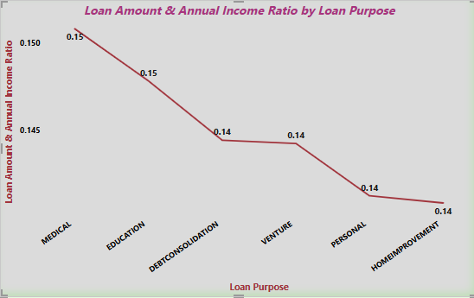
Insights :
Highest Loan-to-Income Ratio:
Medical and Education loans have the highest ratio (0.15), meaning borrowers in these categories take on loans that are a significant portion of their income.
This suggests higher financial strain for individuals borrowing for medical or educational purposes.
Moderate Ratios:
Debt Consolidation and Venture loans have a ratio of 0.14, indicating that these loans are also taken in amounts close to borrowers' earnings.
This might suggest that borrowers in these categories also rely heavily on credit.
Lower Loan-to-Income Ratios:
Personal and Home Improvement loans have the lowest ratio (0.14), meaning borrowers in these categories have a relatively better ability to manage their loan repayments compared to income.
This suggests that loans in these categories may be less risky compared to Medical or Education loans.
Risk Consideration for Lenders:
Medical and Education loans carry the highest financial burden, indicating a higher potential risk of default if the borrower's income remains low.
Lenders should assess repayment capacity carefully for borrowers in these high-ratio categories.
Overall, this chart highlights which loan categories pose a higher financial burden on borrowers, helping lenders adjust lending criteria accordingly.

Slide 7
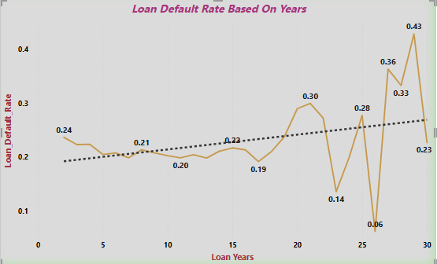
Insights :
The dotted trendline shows an upward pattern, indicating that default rates tend to increase as loan tenure increases.
This suggests that longer loan terms may pose a higher risk of default.
Fluctuations in Default Rate:
The default rate remains relatively stable (0.19 - 0.24) for shorter tenures (0-15 years).
After 20 years, there is a sharp increase, with default rates peaking at 0.43 around 30 years.
High Volatility Beyond 20 Years:
Between 20-30 years, default rates show extreme fluctuations, dropping as low as 0.06 and then spiking to 0.43.
This could indicate that borrowers with very long-term loans face financial uncertainties, leading to irregular repayment behaviors.
Potential Implications for Lenders:
Longer loan tenures (20+ years) require more risk assessment before approval.
Lenders may need to adjust interest rates, require collateral, or introduce stricter eligibility criteria for long-term loans.
Borrowers opting for shorter tenures may have a lower risk of default, making them safer lending prospects.
Key Takeaway:
Shorter-term loans (10-15 years) are more stable and have lower default rates.
Longer-term loans (20+ years) are riskier, with increasing defaults and unpredictable repayment behaviors.

Slide 8
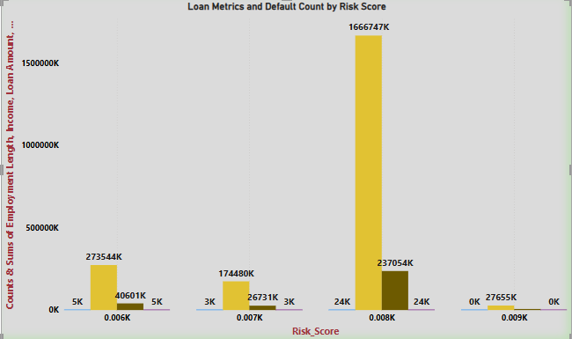
1.Highest Loan Amount & Income at a Specific Risk Score
The Risk Score with the highest loan amount (166,6747K) also has the highest total income (237,054K).
This suggests that borrowers with this risk score are securing the largest loans.
Loan Distribution Across Risk Scores
Some risk scores (e.g., middle category) have significantly higher loan amounts compared to others.
Lower risk scores seem to be associated with lower loan amounts and incomes.
Default Counts Correlation with Loan Amounts
The risk score with the highest total loan amount also has the highest number of defaults (24K).
This indicates that higher loan amounts are potentially riskier, leading to more defaults.
Employment Length Distribution
Employment length counts are relatively stable across risk scores, but higher-income groups tend to have more loan approvals.
This suggests that income may play a larger role than employment length in loan approvals.
Key Takeaway
Higher loan amounts are associated with higher defaults, meaning riskier borrowers may need stricter evaluation criteria.
Lenders should assess both income and risk score together to determine loan eligibility.
Lower-risk borrowers receive smaller loan amounts, possibly due to lower perceived financial needs or cautious lending policies.

Slide 9
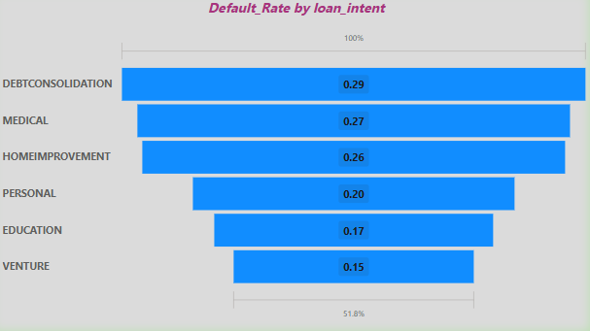
Insights from the Chart:
Debt Consolidation Loans Have the Highest Default Rate (0.29)
Borrowers taking loans for debt consolidation have the highest likelihood of defaulting.
This suggests that those already struggling with debt may still face financial difficulties even after consolidation.
Medical and Home Improvement Loans Also Have High Default Rates (0.27 & 0.26)
Medical loans may indicate unexpected financial burdens that impact repayment ability.
Home improvement loans could be riskier due to unplanned expenses or unstable financial situations.
Lower Default Rates for Venture and Education Loans (0.15 & 0.17)
Venture loans (business-related) have the lowest default rate, possibly due to profit generation helping with repayments.
Education loans also have a lower default rate, likely due to steady future income prospects from employment.
Key Takeaway
Lenders should carefully assess debt consolidation and medical loan applications, as they have higher default risks.
Borrowers seeking venture and education loans pose lower risks, making them safer lending options.
Risk-based pricing strategies (higher interest rates for high-risk intents) could help mitigate losses.

Slide 10
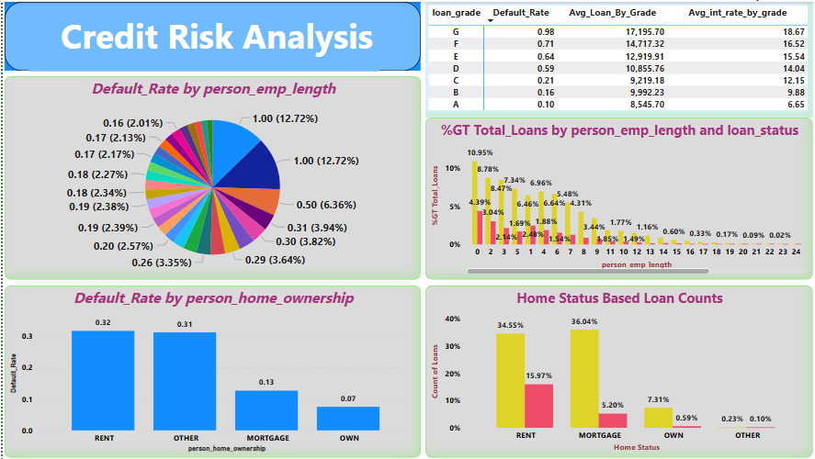

Slide 11
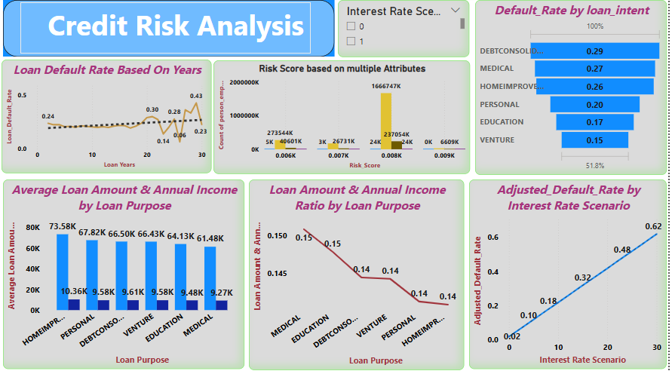

Slide 12
Insights from the Dashboards
1. Home Ownership & Default Risk:
Renters (0.32) and those in 'Other' ownership (0.31) categories have the highest default rates, indicating financial instability.
Homeowners (0.07) and mortgage holders (0.13) have lower default rates, suggesting greater financial discipline and stability.
2. Loan Purpose & Default Trends:
Debt Consolidation (0.29), Medical (0.27), and Home Improvement (0.26) loans have the highest default rates.
Education (0.17) and Venture (0.15) loans have the lowest default risk, likely due to potential income generation.
Lenders should apply stricter credit assessments for high-risk loan purposes.
3. Loan Amount vs. Annual Income:
Home Improvement loans have the highest average loan amount ($10.36K) despite a moderate-income level ($73.58K).
Medical loans show the highest loan-to-income ratio (0.15), indicating financial strain on borrowers.
A lower ratio in other categories suggests borrowers are taking manageable loans compared to income levels.
4. Loan Tenure & Default Probability:
Longer loan tenures (>20 years) show a rising trend in default rates.
A notable default spike occurs around 25-30 years, with peaks reaching 0.43.
Shorter-term loans tend to have more stable repayment patterns.
5. Risk Score & Loan Defaults:
Higher-risk score groups have a significantly higher count of loan defaults.
The majority of defaults occur in segments with a high loan amount and lower income levels.
Risk-based pricing and enhanced screening for high-risk borrowers could help mitigate losses.
Final Outcome & Recommendations:
Lenders should prioritize lower-risk homeownership categories (Mortgage, Own) for loan approvals.
Medical and Debt Consolidation loans require stricter risk assessment due to high default rates.
Longer-term loans (>20 years) pose higher risks; lenders should evaluate repayment capacity carefully.
Borrowers with high-risk scores and large loan amounts should undergo enhanced credit screening.
Stronger risk-mitigation strategies (collateral, insurance, or interest rate adjustments) can reduce default impact.
These insights can help optimize lending decisions, minimize defaults, and improve overall loan portfolio health.

Slide 13

Link for the explanation video: https://www.youtube.com/watch?v=Pj-jTCMX5sA

